Slide 1
FPGA-
Introduction to LUTs
CE233(CAD), Lecture 4:
Mehdi Modarressi
Department of Electrical and Computer Engineering,
University of Tehran

Slide 2
Reading:
  Spartan-3 Generation FPGA User Guide, Xilinx ug331 (v1.8)
  “FPGA Prototyping By VHDL Examples- Xilinx Spartan-3 Version”, Chapter 2
  “The Design Warrior's Guide to FPGAs”, Chapter 4

Slide 3
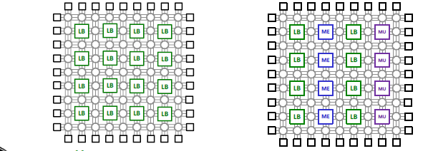
FPGA
Field Programmable Gate Array
Uses SRAM for configurable parts
Uses LUT (lookup table) to implement logic

Slide 4
Lookup table (LUT)
FPGAs implement logic functions using a lookup table (LUT)
  An alternative to PAL-based implementation
An n-input LUT can implement any n-input function
a | b | c | f
0 | 0 | 0 | 0
0 | 0 | 1 | 0
0 | 1 | 0 | 1
0 | 1 | 1 | 0
1 | 0 | 0 | 1
1 | 0 | 1 | 0
1 | 1 | 0 | 1
1 | 1 | 1 | 0
F=(a+b)× c’
1×8 RAM
0
0
1
0
1
0
1
0
a
b
c
Address Decoder
Address lines
Truth table

Slide 5
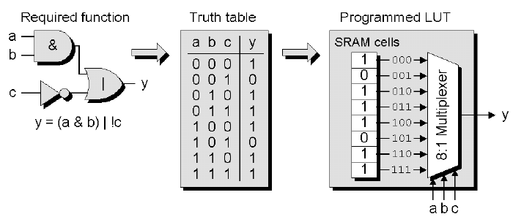
LUT-Based FPGAs
The inputs, in addition to address decoder (see the previous slide) can also be applied to a multiplexer

Slide 6
LUT vs PAL
F=(a+b)× c’
AND gates inputs
0
1
2
3
4
5
6
7
8
9
Product
1
X
term
2
X
X
F
1
3
1×8 RAM
0
0
1
0
1
0
1
0
I
1
5
A
a | b | c | f
0 | 0 | 0 | 0
0 | 0 | 1 | 0
0 | 1 | 0 | 1
0 | 1 | 1 | 0
1 | 0 | 0 | 1
1 | 0 | 1 | 0
1 | 1 | 0 | 1
1 | 1 | 1 | 0
4
X
X
X
5
X
X
F
2
6
X
X
a
b
c
I
2
5
B
Address Decoder
7
X
X
8
X
X
F
3
9
X
I
3
5
C
10
X
X
11
X
X
F
4
12
X
Address lines
I
4
Truth table
0
1
2
3
4
5
6
7
8
9

Slide 7
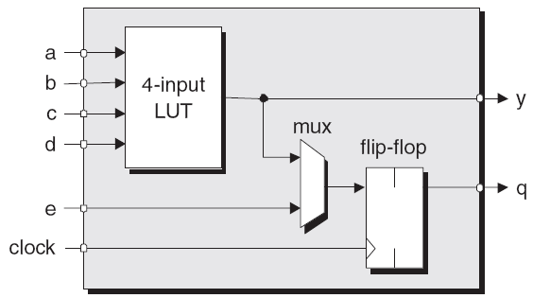
Simple FPGA block
A very simple programmable logic block using LUTs

Slide 8
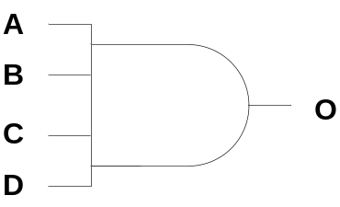
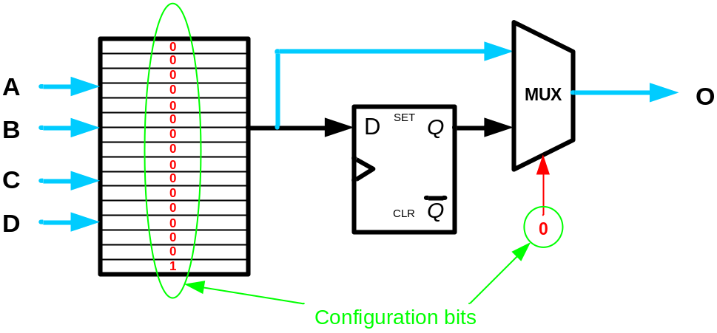
FPGA programming
A | B | C | D | O
0 | 0 | 0 | 0 | 0
0 | 0 | 0 | 1 | 0
0 | 0 | 1 | 0 | 0
0 | 0 | 1 | 1 | 0
0 | 1 | 0 | 0 | 0
0 | 1 | 0 | 1 | 0
0 | 1 | 1 | 0 | 0
0 | 1 | 1 | 1 | 0
1 | 0 | 0 | 0 | 0
1 | 0 | 0 | 1 | 0
1 | 0 | 1 | 0 | 0
1 | 0 | 1 | 1 | 0
1 | 1 | 0 | 0 | 0
1 | 1 | 0 | 1 | 0
1 | 1 | 1 | 0 | 0
1 | 1 | 1 | 1 | 1
Programming is done by writing proper bits
in the LUTs and multiplexer select lines
Example: 4-input AND gate

Slide 9
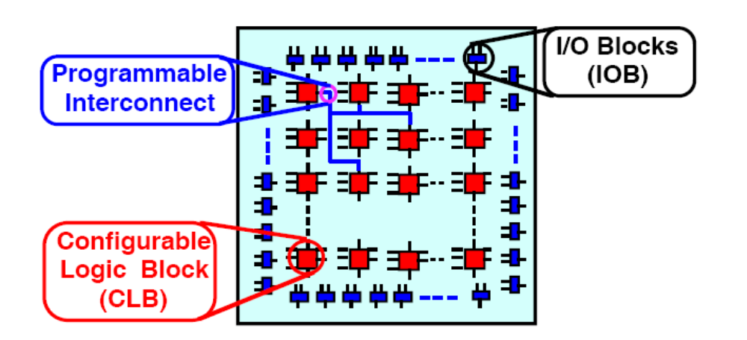
Example: Xilinx XC4000
A simple FPGA introduced in the 80’s
Array of Configurable Logic Blocks (CLBs)
SRAM-based
Source: lecture 10 by Hassan Bhatti

Slide 10
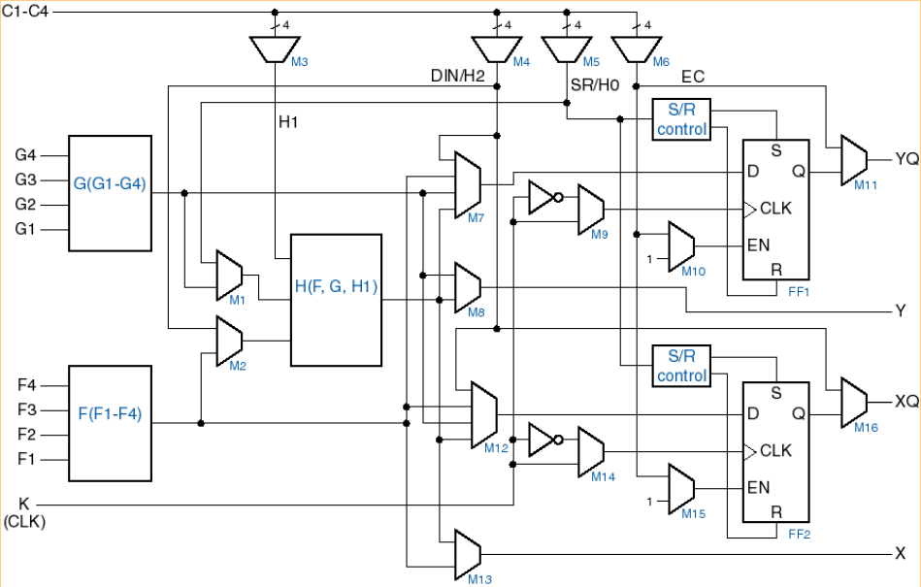
Xilinx XC4000 FPGAs- CLB

Slide 11
Xilinx XC4000 FPGAs- CLB
F and G LUTs: 4 input -> 16 bits of RAM (each)
H LUT : 3 input –> 8 bits of RAM

Slide 12
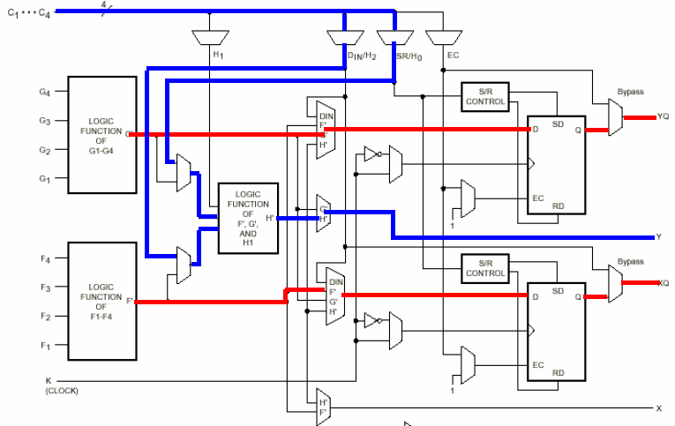
Xilinx XC4000 CLB configuration
Two 4-input functions, registered output input functions, and one 2-input function with combinational output

Slide 13
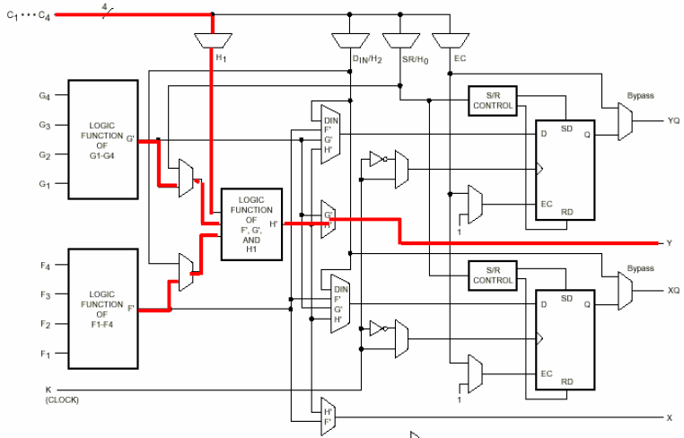
Xilinx C4000 CLB configuration
5-input function, combinational output

Slide 14
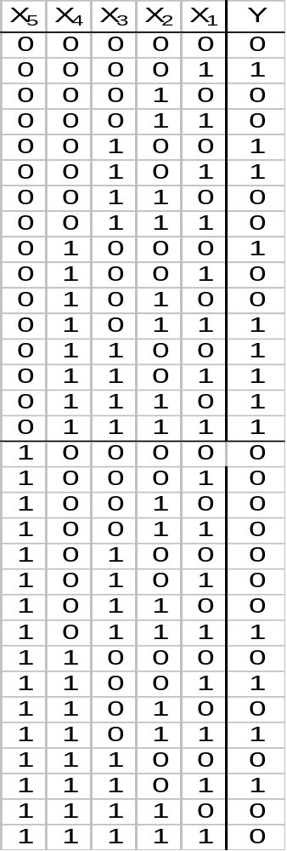
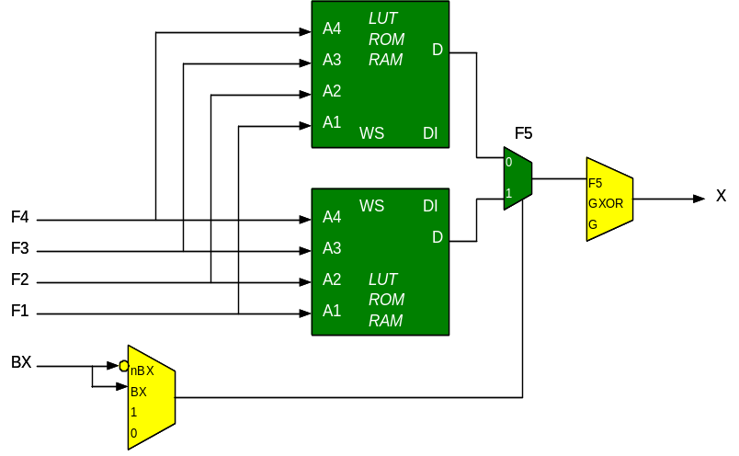
(X+1)-Input LUT by x-input LUTs
Two 4-inpu LUTs can implement two 4-input functions
By adding a multiplexer like below, they can implement any 5-input functions
Why?
LUT
LUT
OUT
LUT
LUT

Slide 15
(X+1)-Input functions by x-input LUTs
Two n-input LUTs and one 3-input LUT can implement any (n+1)-input function
Why?

Slide 16
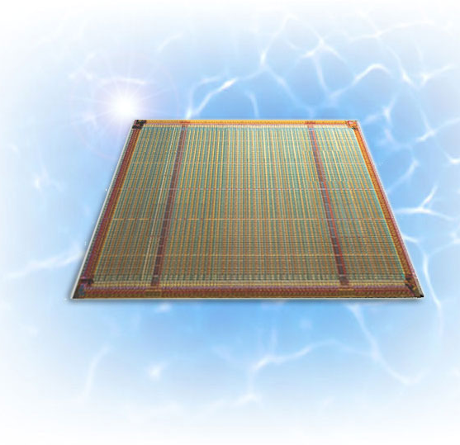

Spartan-3 FPGAs
Spartan: Cost-effective FPGA family of Xilinx
  Spartan-6 is the last generation of the family
  Cheaper and smaller than Virtex (the high-performance FPGAs of Xilinx)
The industry’s first 90 nm FPGA
Different generations: Spartan-3, Spartan-3E, Spartan-3A

Slide 17
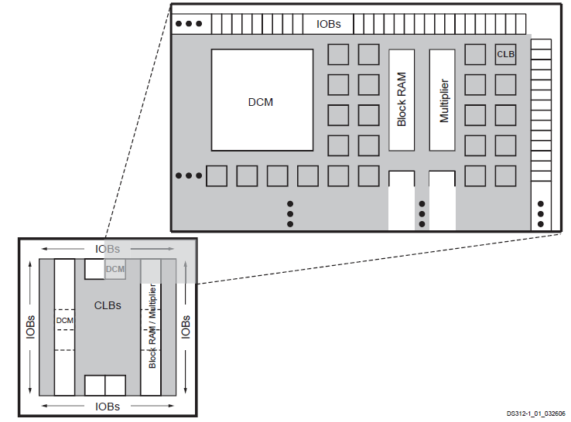
Spartan-3 architecture
Source: Spartan-3 Generation FPGA User Guide, Xilinx ug331 (v1.8)

Slide 18
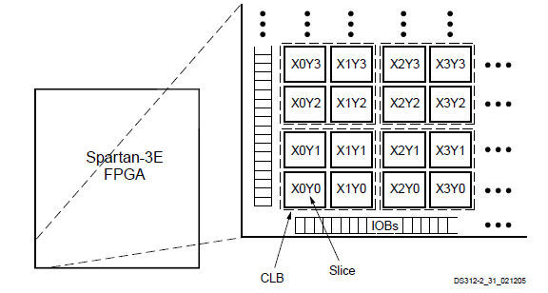
Configurable Logic Blocks (CLB)
Main logic resource for implementing synchronous as well as combinatorial circuits
Arranged in a regular array of rows and columns
Source: Spartan-3 Generation FPGA User Guide, Xilinx ug331 (v1.8)

Slide 19
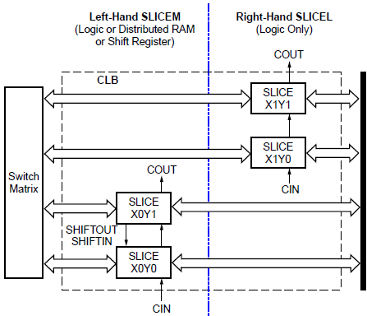
CLB and slice
Each Spartan-3 CLB contains four slices
Fast interconnects among the slices of a CLB
Source: Spartan-3 Generation FPGA User Guide, Xilinx ug331 (v1.8)

Slide 20
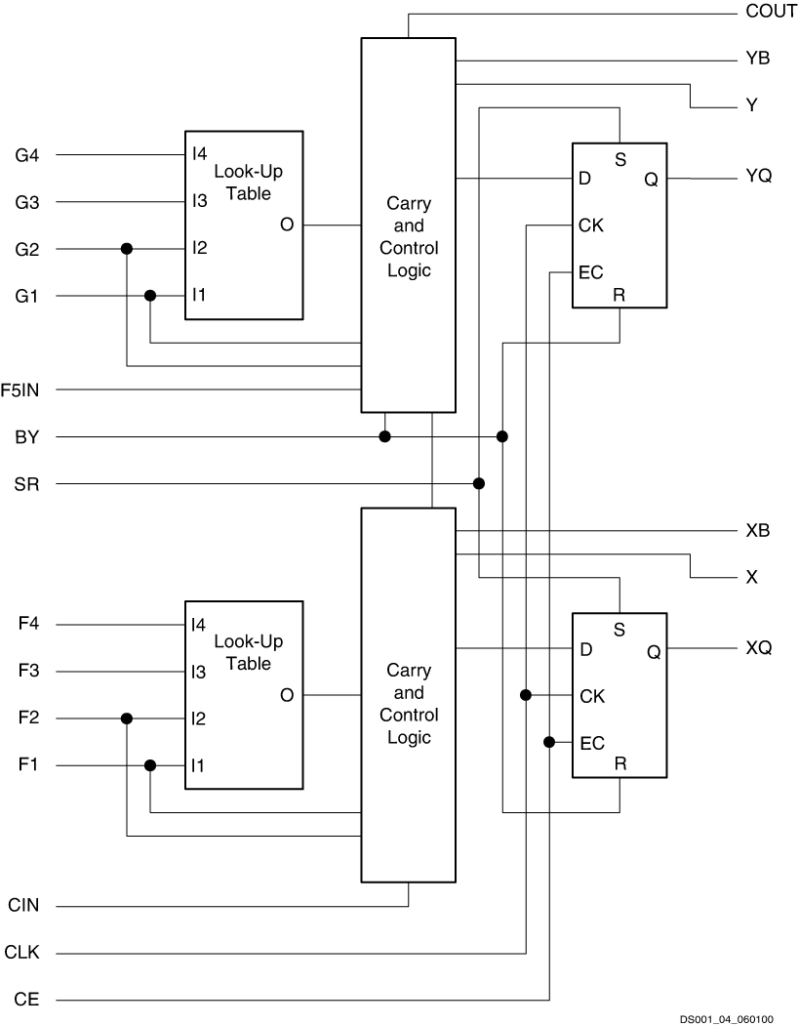
CLB and slice- slice architecture
Source: Spartan-3 Generation FPGA User Guide, Xilinx ug331 (v1.8)

Slide 21
SLICE structure
Two 4-input look-up tables followed by two D flip-flops plus carry & control logic (for arithmetic operations)

Slide 22
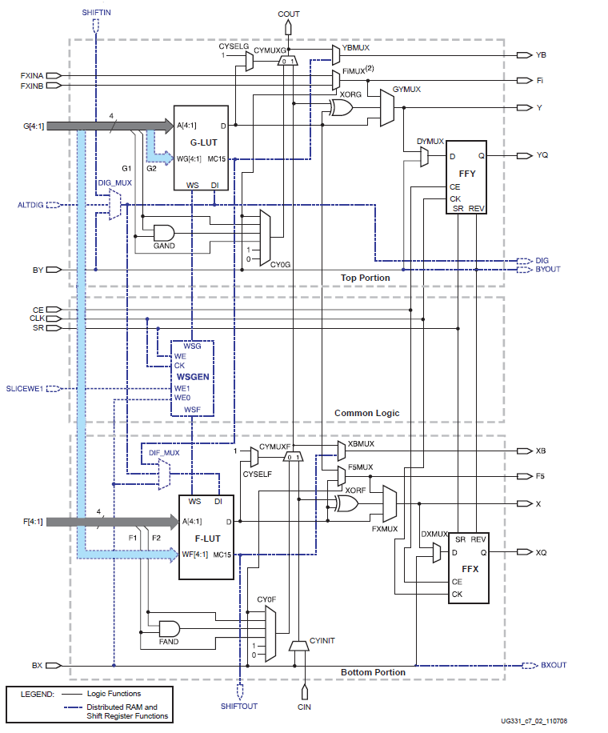
SLICE structure
The details of the slice architecture
More detailed than the figure in the previous slide!
  The control and carry logic are shown

Slide 23
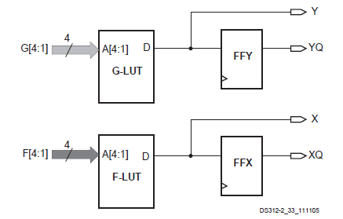
Main logic paths
Two 4-input functions, combinational or sequential output

Slide 24
Wide multiplexers
Combine LUTs to build more complex logic operations
Each slice has two of these multiplexers
  F5MUX in the bottom
  FiMUX in the top

Slide 25
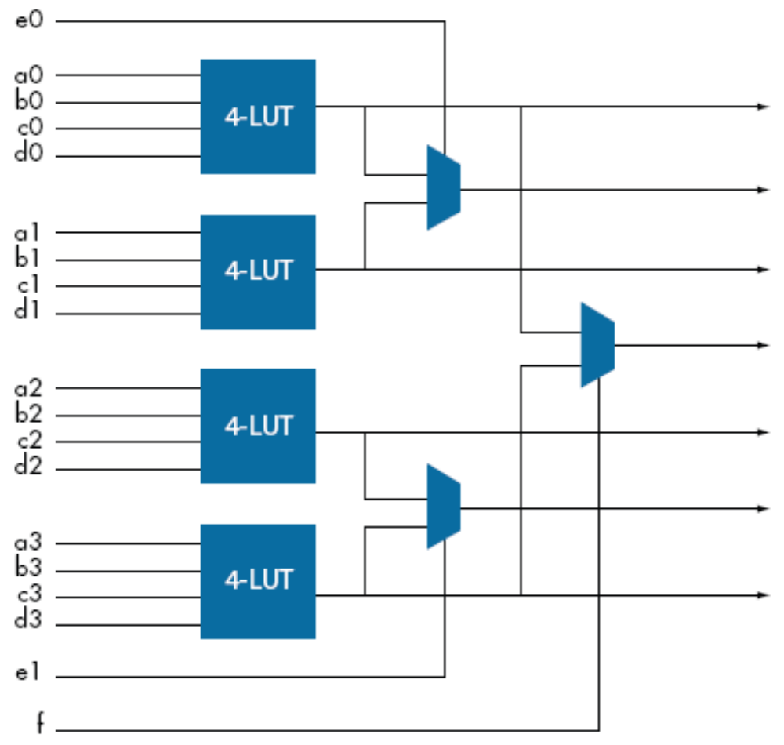
Making larger LUTs from Smaller LUTs

Slide 26
Making larger LUTs
The four slices of a CLB can be merged to make functions with 5, 6, 7, and 8 input functions
Right-Hand SLICEL
Left-Hand SLICEM
COUT
COUT
Switch
Matrix
Slice X1Y1
Slice X1Y0
SHIFTIN
Slice X0Y1
Slice X0Y0
Fast Connects
CIN
SHIFTOUT
CIN

Slide 27
Making larger LUTs in Spartan CLB
  F5MUX : multiplexes the two LUTs in a slice
  F_{i}MUX :
  i=6,7,8
  multiplexes the F5MUX and FiMUX of the same slice or other slices
MUXF8 combines the two MUXF7 outputs (from the CLB above or below)
CLB
F8
Slice S3
F5
MUXF6 combines slices S2 and S3
F6
Slice S2
F5
MUXF7 combines the two MUXF6 outputs
F7
Slice S1
F5
MUXF6 combines slices S0 and S1
Slice S0
F6
F5
MUXF5 combines LUTs in each slice

Slide 28
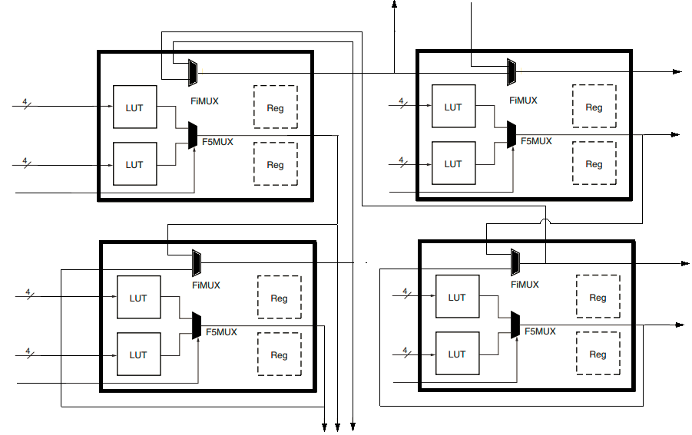

Slide 29
Cascading LUTs
Previous slide used wide multiplexers to implement large functions
It can implement any function with 4, 5, 6, 7, and 8 inputs
Some functions can be re-formed and implemented by cascading LUTs, rather than combining with multiplexers
  May use smaller number of LUTs
  Not applicable always, depends on the function

Slide 30
Example
Implement the following functions on a single CLB of the XC4000 FPGA:
    X = A’B’ (C + D)
    Y = AK + BK + C’D’K + AEJL
Use look up table F to implement X
Use look up table G for AEJL
Use F, G and H for Y:
    Y = K(A+B + C’D’) + AEJL
    = KX’ + AEJL= KF’+G

Slide 31
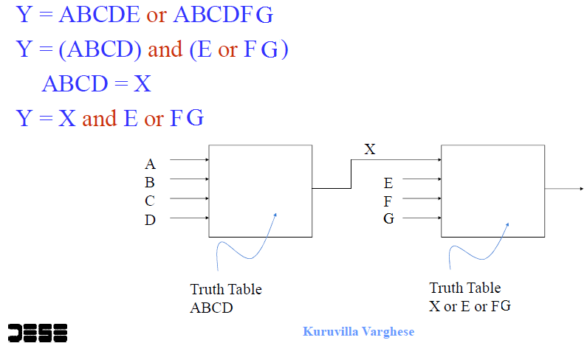
Cascading LUTs
Example: 2 cascaded LUTS for a 7-input function.
How many LUTs when using wide MUXes?

Slide 32



Programming a CLB
K

Slide 33
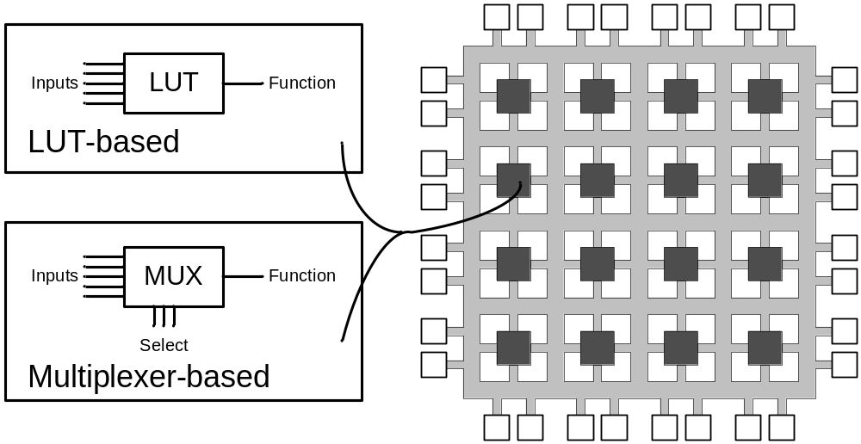
LUT implementation
In addition to SRAM, LUTs and be implemented by multiplexers

Slide 34
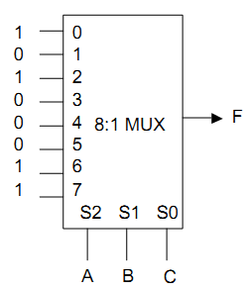
Multiplexers as function generator
You have seen it in Digital Design course
2^{n}:1 multiplexer implements any function of n variables
  variables used as control inputs
  Data inputs tied to 0 or 1
  Example:
  F(A,B,C) = m0 + m2 + m6 + m7
  = A'B'C' + A'BC' + ABC' + ABC

Slide 35
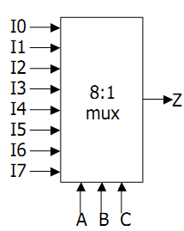
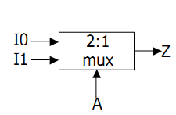
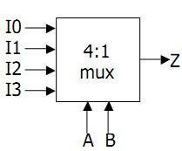
Multiplexers as function generator
2:1 mux: Z = A' I0 + A I1
4:1 mux: Z = A' B' I0 + A' B I1 + A B' I2 + A B I3
8:1 mux: Z = A'B'C'I0 + A'B'CI1 + A'BC'I2 + A'BCI3 +
AB'C'I4 + AB'CI5 + ABC'I6 + ABCI7

Slide 36
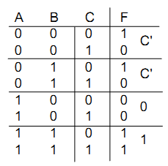
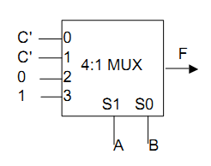
Multiplexers as LUTs- extention
2^{n-1}:1 mux can implement any function of n variables
  n-1 variables used as control inputs
  data inputs tied to 0 or 1 or the last variable or its complement
F(A,B,C) = m0 + m2 + m6 + m7
  = A'B'C' + A'BC' + ABC' + ABC
  = A'B'(C') + A'B(C') + AB(1) + AB'(0)

Slide 37
LUT-Based FPGAs

Slide 38
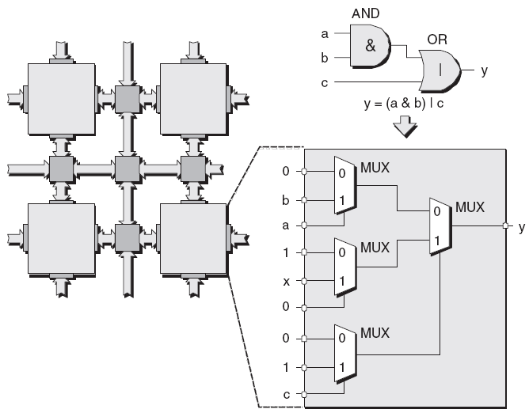
MUX-based Logic Block

Slide 39
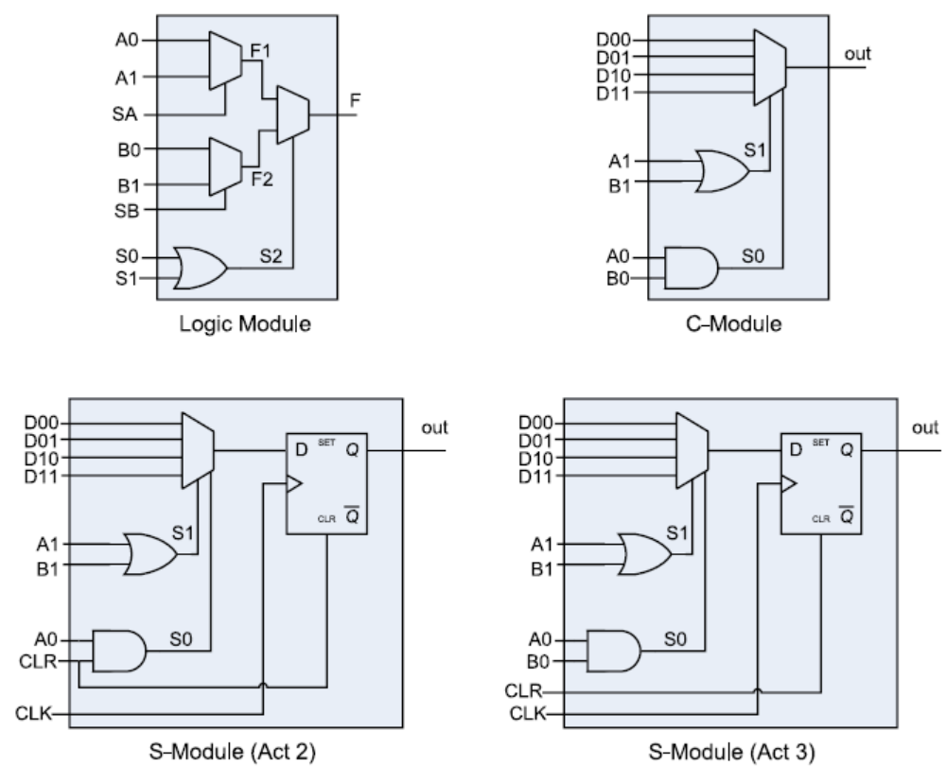
Actel ACT X Logic Module

Slide 40
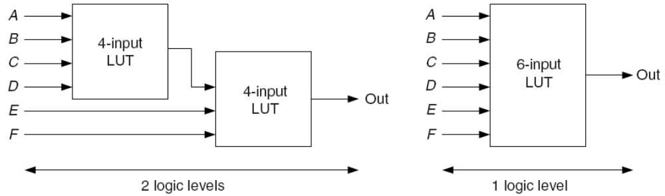
LUT size
Large size:
  More inputs
    more complex functions (+)
    doubles the number of SRAM cells (-)
    Not possible to completely fill each logic block
Small size
  More delay due to more logic blocks for critical path

Slide 41
LUT Size
Research results indicates that a basic 6-LUT could yield a 14% performance improvement by reducing the number of levels of logic elements on the critical paths of circuits.
But 30% of the functions can fully exploit 6-input LUTs
A 17% area increase resulting from a larger LUT-mask and more inputs for the LUT.
Solution: Adaptive LUT size
  Using wide multiplexers to combine LUTs
  Divide large LUTs into smaller ones internally
    Example: Xilinx Series-7 CLBs

Slide 42
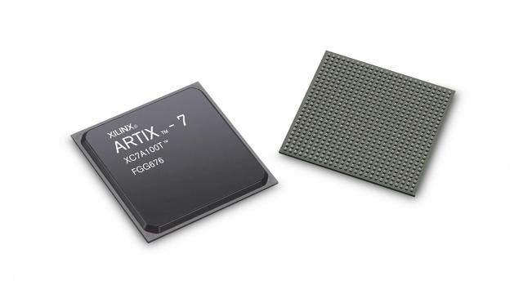
LUT structure
Xilinx 7-series FPGAs
Artix-7, Virtex-7,…

Slide 43
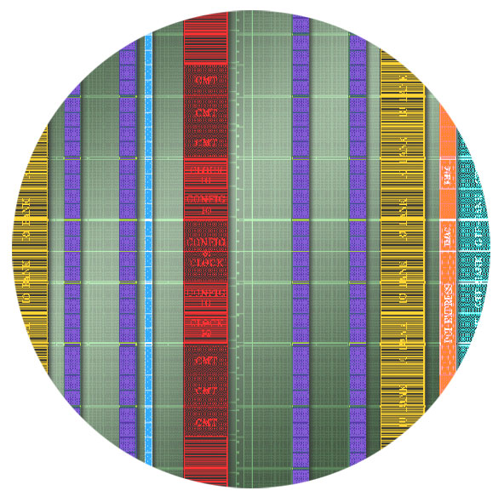

CLB in Artix-7
Each CLB has two slices
Slices still can be either SliceM and SliceL
COUT
COUT
Switch
Matrix
CIN
CIN

Slide 44
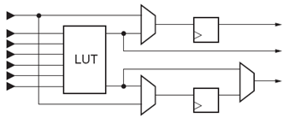
Slice structure
Each slice has four 6-input LUTs
LUT/RAM/SRL
LUT/RAM/SRL
LUT/RAM/SRL
LUT/RAM/SRL
0 1

Slide 45
6-Input LUT with Dual Output
6-input LUT can be two 5-input LUTs with common inputs
  Any function of six variables or two independent functions of
  five variables
6-LUT
A6
A5
A4
A3
A2
A1
A5
A4
A3
A2
A1
5-LUT
D
O6
A5
A4
A3
A2
A1
5-LUT
D
O5
Notes:
LUTs can perform any combinatorial function limited only by the number of inputs. It is your primary combinatorial logic resource and it is the industry standard.
The look-up table functionality is essentially a small memory containing the desired output value for each combination of input values.
The truth table for the desired function is stored in the memory.
The inputs of the function act as the address to be read from the memory (essentially a multiplexer controlled by the inputs).
The values for the storage elements are generated by the ISE® software tools, and downloaded to all LUTs at configuration time.
Each 6-input LUT can be configured as two 5-input LUTs. This gives the device a great deal of flexibility to build an efficient design.
Thus, the LUT can be used to build any function of six variables or two independent functions of five variables.
The synthesis and implementation tools use these resources to build combinatorial functions automatically.

Slide 46
Wide Multiplexers
Each F7MUX combines the outputs of two LUTs together
  Can implement an arbitrary 7-input function
  Can implement an 8-1 multiplexer
The F8MUX combines the outputs of the two F7MUXes
  Can implement an arbitrary 8-input function
LUT/RAM/SRL
LUT/RAM/SRL
LUT/RAM/SRL
LUT/RAM/SRL
0 1
Notes:
The synthesis and implementation tools will automatically map logic to the F7MUX and F8MUX when appropriate.

